Slide 1
Can one find solace in a materialistic world and yet lead a spiritual path?
The answer is YES!
Experience & Evolve

Slide 2


Slide 3
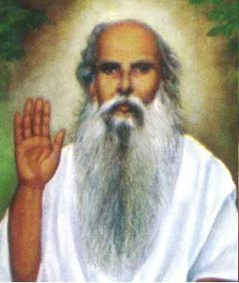
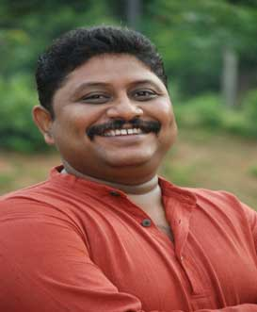
THE MYSTIC EVOLUTION
Sri Sri Sri Chittibabaji Varu
Sri Sri Sri Jagga Babu Garu

Slide 4
SRI SADGURU CHITTIBABAJI SAMASTHAN
Sri Sri Sri Chitti Babaji can bestow on you all that you wish and strain to obtain from absolutions in holy rivers, from holy pilgrimages, penance, meditation and turning of beads, from devotion, renunciation and knowledge supreme!
“You need to only see him”
In Today’s world though man’s life-span and austerity of practice have steadily decreased, under the Grace of Sadguru Sri Chittibabaji, GOD can be experienced and Man can evolve into a Mystic spiritual bliss.

Slide 5
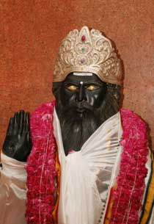
STEPS TO VAIKUNTHA
(Babaji’s Kind Words)
I shall carry the basket of your life. Only lift it on to my head.
If you are awake to the truth about your place of rest, there is no need to sleep.
Light the lamp even in full air, but keep faith in me, and it burns.
The one that knows the emptiness to be filled does become a perfect person.
If you can not hold my hand, give me your hand and I shall hold it.
If you consider your body but clothes to be thrown off tomorrow, your conscience shall not be polluted.
You can not ever imagine what I can give you. Then it is meaningless to desire.
Find the place where ‘YOU’ are not, and ‘I’ am there.
You may enjoy this fair from my embrace, who knows how you miss your way if you leave.
It is enough if you remember that I am always watching you. Your conduct becomes willingly holy.
Why do you tire yourself, forcing back Maya or illusion with both your hands restlessly? Hold my feet gracefully. It will suffice.

Slide 6
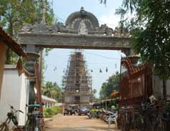
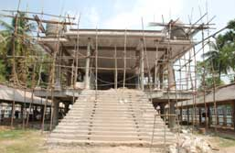
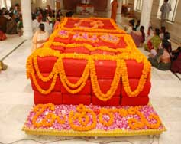
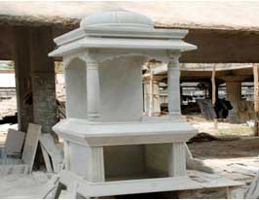
Be a part of Mystic Evolution

Slide 7
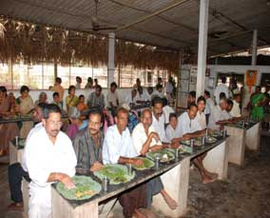
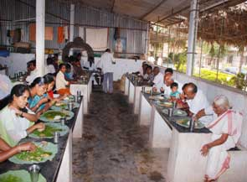
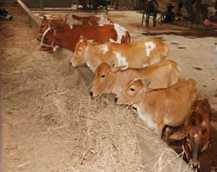
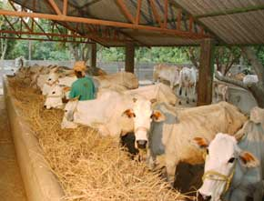

Slide 8

1:108 PRADAKSHANA
Surrounding the main temple 108 sthupas are
coming up each accommodating,
  One crore written ‘Rama Namam’ (written by devotees).
  One Guru Nama inscribed one each sthupa.
  A Nanda deepa that is kept alight 24hrs of the day.
  A Thulasi plant
  A Miltch cow
  A Bilwa Plant
  A Statue of Sri Panduranga.
Through this, unique structured Sthupas, at a
single site a devotee gets an opportunity to
do Pradakshana of 108 crore Rama Nama,108
Gurunama, 108 Nandadeep, 108 Thulasi
plants, 108 Miltch cow, 108 Bilwa plants and
108Sthupas of Sri. Panduranga and that too
at onego in a single round.
One crore written ‘Rama Namam’ (written by devotees).
A Statue of Sri Panduranga
One Guru Nama inscribed one each sthupa.
STHUPA
A Bilwa Plant
A Nanda Deepa that is kept alight 24hrs of the day.
A Miltch cow
A Thulasi plant.

Slide 9
Self Evolution-Find the purpose of your life
Visit the Ashram
Involve in Mystic experience
BE A MULTI-LEVEL SEVAK for Human service.
Find peace in materialistic world with spiritual bliss

Slide 10
The classic mystic evolutions (To Name a Few)
Babaji blessed thousands of childless couples with children, so much so that he earned reputation as the saint of children. Even from his Samadhi or tomb today this kindness to woman continues. Smt Maganti Mangaveni was the first to gain motherhood through prayers at Babaji’s Samadhi.
    Fourteen years after her marriage and when all medical aids and religious vows having yielded no fruit, when she despaired of bearing a child, she was asked by Jagga Babu, whom Babaji had chosen for his service and given a new lease of life, asked her to go round Babaji’s Samadhi in a Pradakshana performing nama-japa and take his prasaadam. With ardent faith she did so and in due course became a mother.
    In another instance, Smt Dull Krishnavenamma lost her child at birth, Then Babaji went to her and brought her dead child back to life, thus giving her a mother’s bliss. Her pregnancy was abortive twice before this incident took place. For long years she had no pregnancy at all. And this time the baby was still born owing to a complication in delivery and an accident on the way to a hospital. She herself was in danger of death. Under these fateful circumstances the doctors separated the dead child from its mother and put it in a tray. Thirty minutes later the child came to life with the touch of Babaji’s hand. These miraculous happenings amazed the hospital staff and members of Krishnavenamma’s family. Babaji can put together broken bones of a skeleton and make it sit erect if he takes kind to it.

Slide 11
The classic mystic evolutions
In the decade beginning 1970, the son of the Diwanji of Mohanapuram estate was a victim of T.B. in an advanced state. He was brought to Babaji by his kith and kin. His coughing and vomiting of blood was piteous. The patient, Ramakrishna was admitted to the ashram and Babaji gave severe blows on his cheek thrice which miraculously cured him of his T.B in about eighteen months. Ramakrishna also participated in the austerities of Chaturmasya-vratha, cooking food with country wood as fuel for ten/twelve hours a day for four months. And the smoke and the strain and the heat of the fire could do no damage to Ramakrishna’s lungs.
After Babaji took Samadhi, Bommireddy Satyanaraya of Kondepudi village in Sitanagaram Mandal suffered from lever cancer when he was 27 years old. He became thin to bones while undergoing treatment at Korukonda hospital. While he was in this state he received the Devine Ash (Vibhooti) through Shri Jagga babu. Though he had no faith in God, he had to smear a bit on his head due to pressures from his family members, and he started drinking water mixing a pinch of that vibhooti. He could establish faith the powers of Babaji as he gradually relieved of the intensity of suffering in a week’s time. And on his desire he was brought to Babaji’s Ashram by his relatives. Shri Jaggubabu advised him to come whenever possible, have meals and take rest there. He did so, frequently. When he went to the doctor for check up after three months cancer was not detected. Since then he has been following the path that Babaji shown him with good faith and serving Babaji.
    Read the Chittibabaji Guru Charitra for more such classic evolutions

Slide 12
Let’s join Hands and become Change agents in
Mystic Evolution
The poet Hafiz wrote
"The sun never says to the earth,
'You owe me.'
Look what happens with a love like that.
It lights up the whole sky."
    Similarly, Let us spread the light of love through our actions and contributions!
Temple Construction
Sthupas
Nithyaanadhana
Godana
Adoption of a cow
All the donations to the Ashram are exempt from income tax under 80G of income tax Act.
For online donations visit the website.

Slide 13
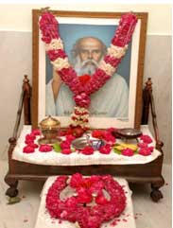
"I searched for God and found only myself. I searched for myself and found only God".
Salutations to
Sri Sri Sri Sadguru Chittibabaji Varu!

